Slide 1
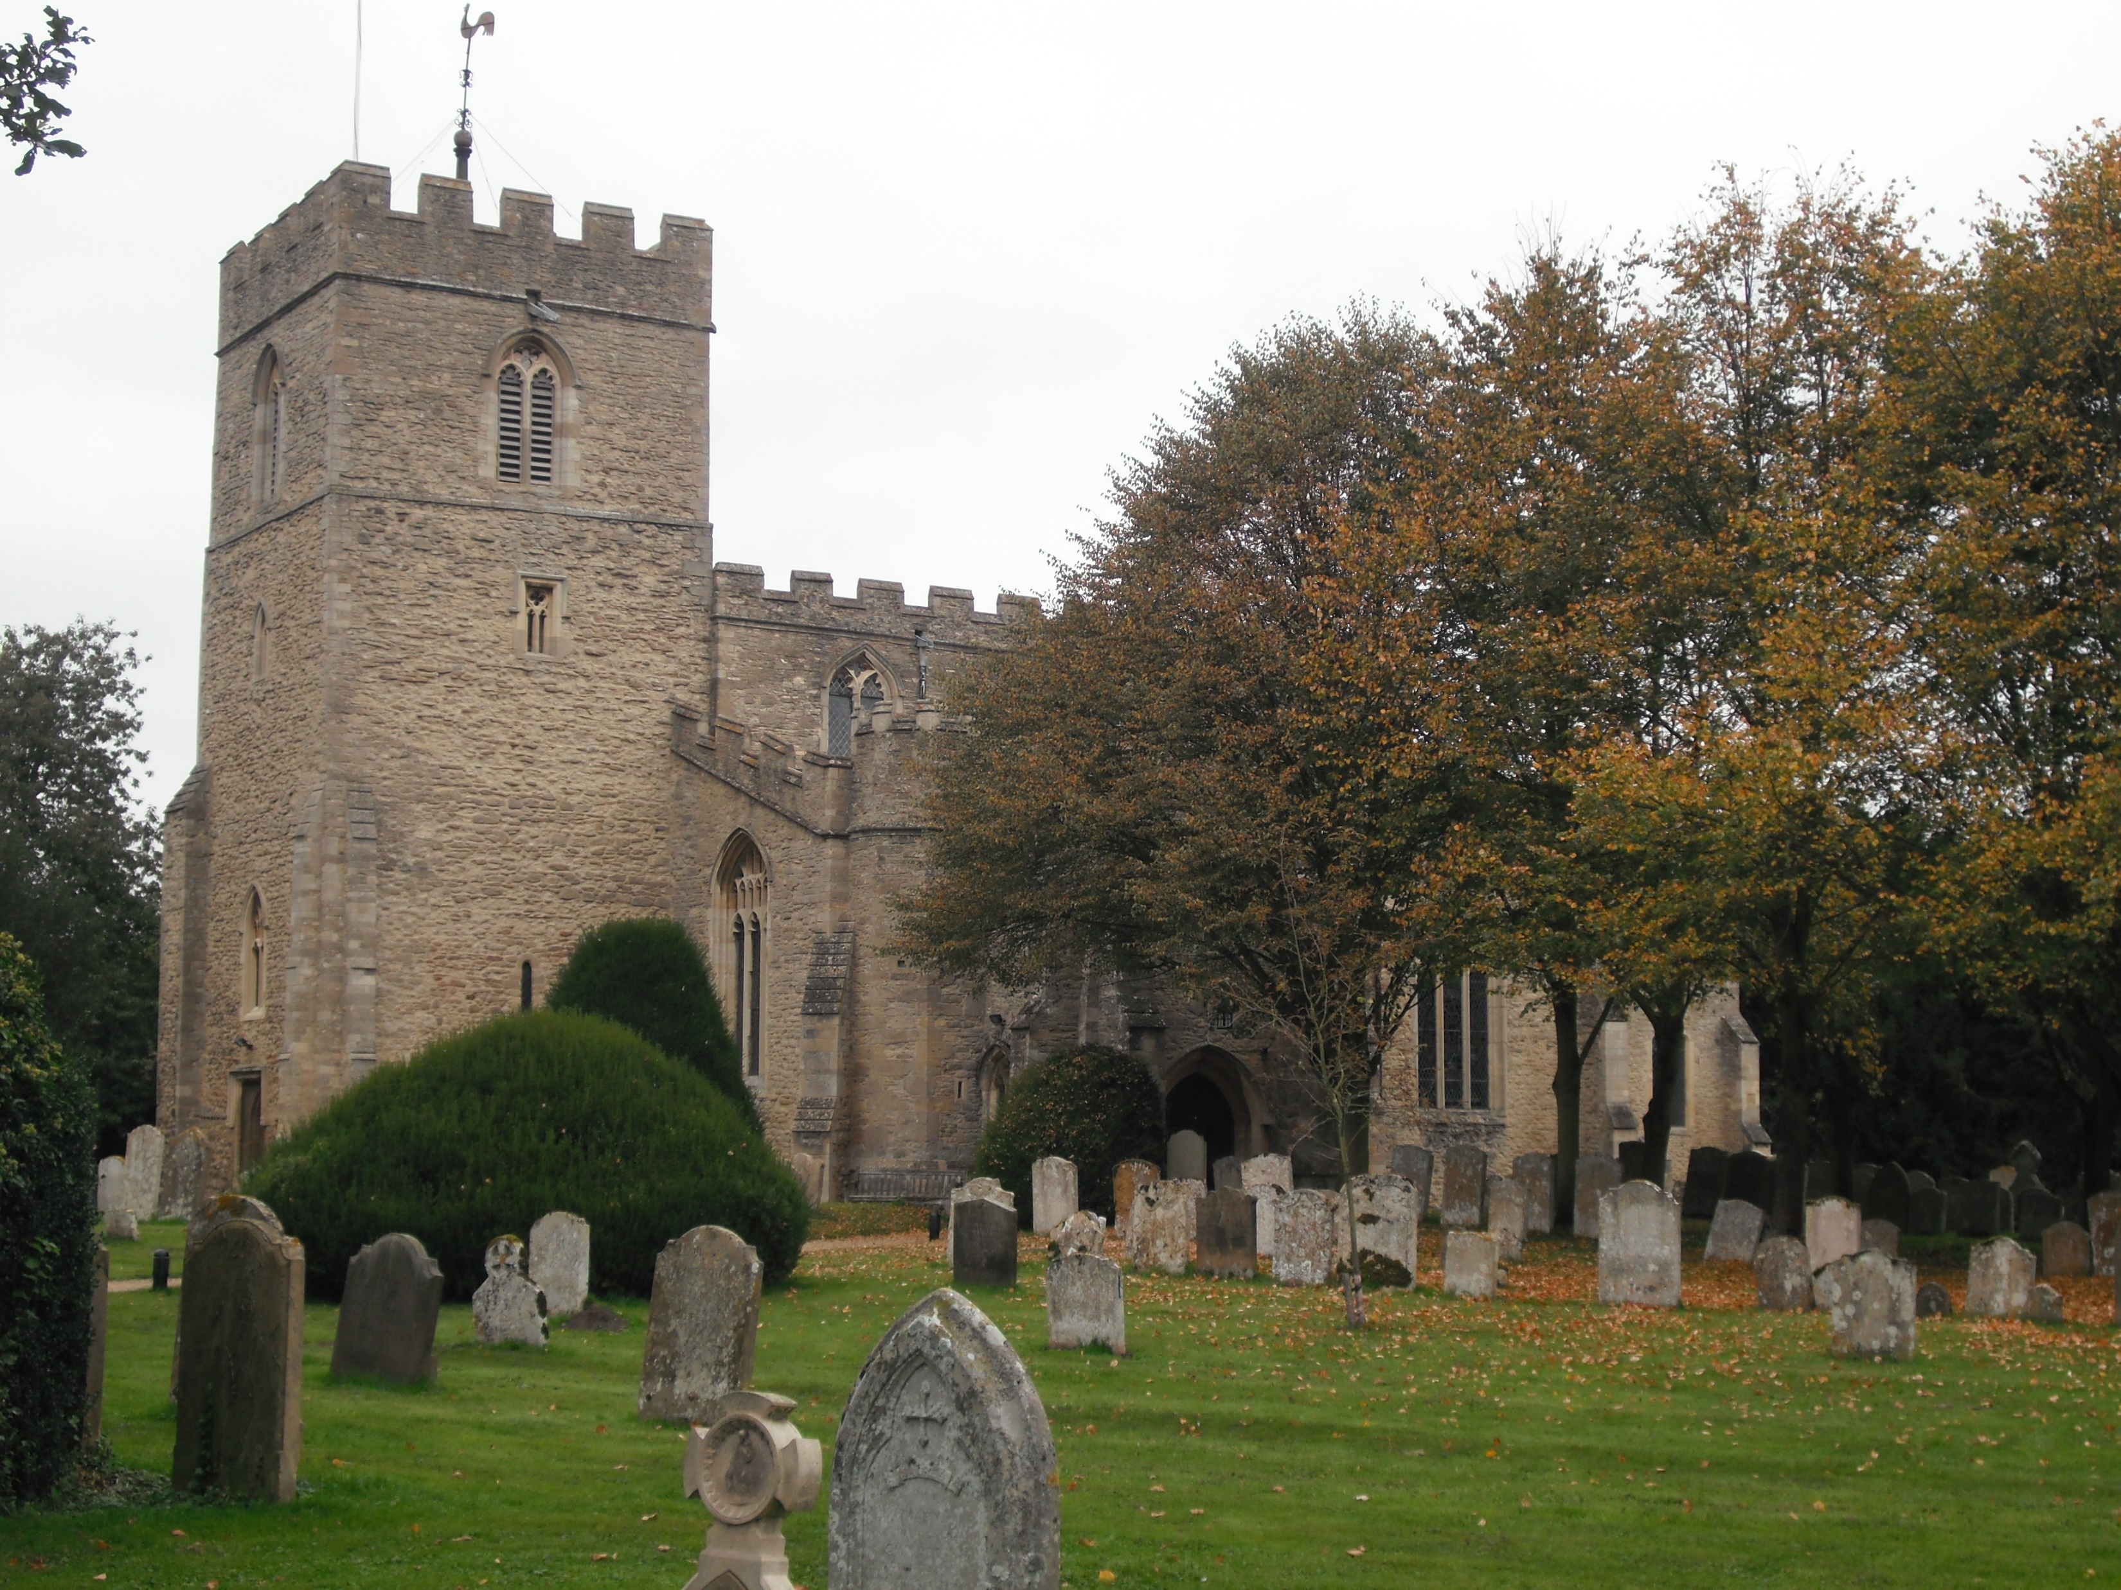
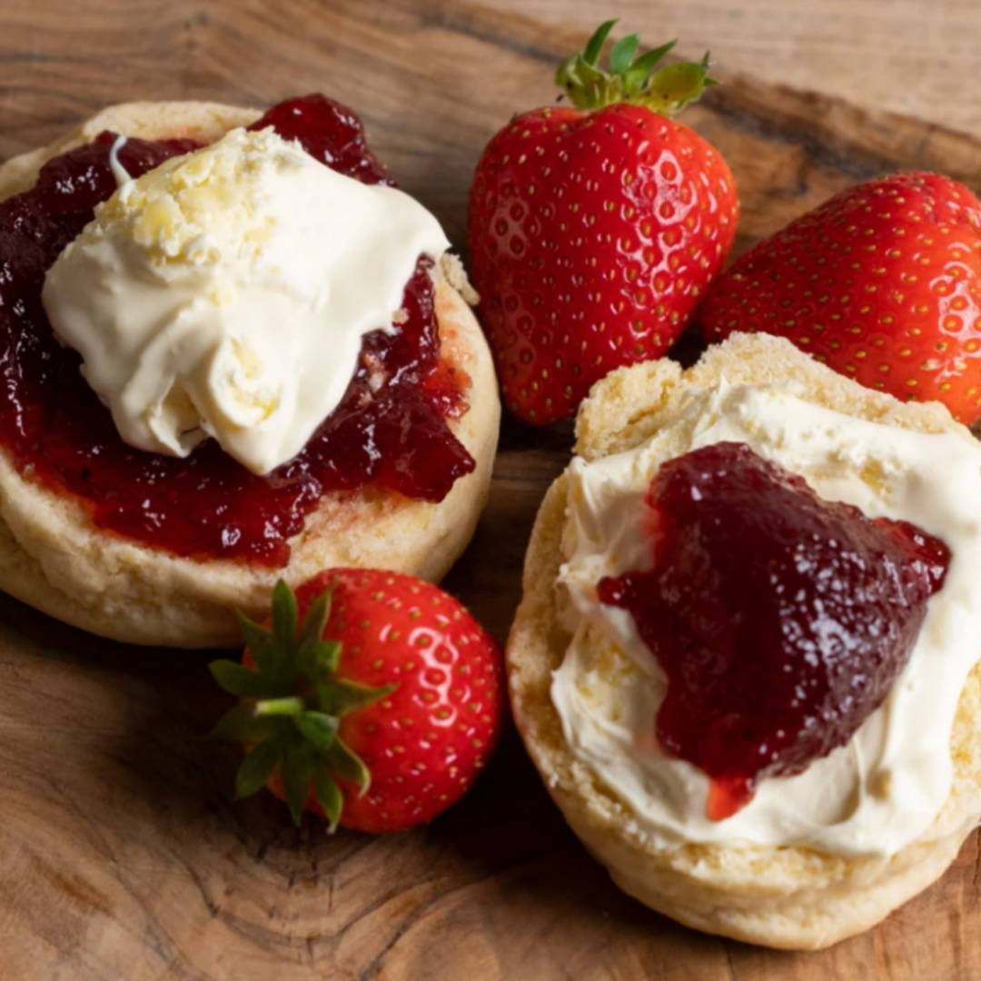
All Saints Church Kempston
Invite you to
Traditional Cream Teas, followed by a Talk about the History
of this 900 year old Kempston Church.
Explore the church and grounds which lead down to the River Ouse.
Church End, Kempston,
Post code MK43 8RH, free parking
Saturday 28th June from 2 until 4pm
Donations appreciated
All proceeds to All Saints Church
General Funds.
If you are attending it would helpful
if you could inform us please
for Catering purposes.
Tel:/whatsApp Jan Long - 07969836341

